Slide 1
Data Structures and Algorithm Analysis

Slide 2
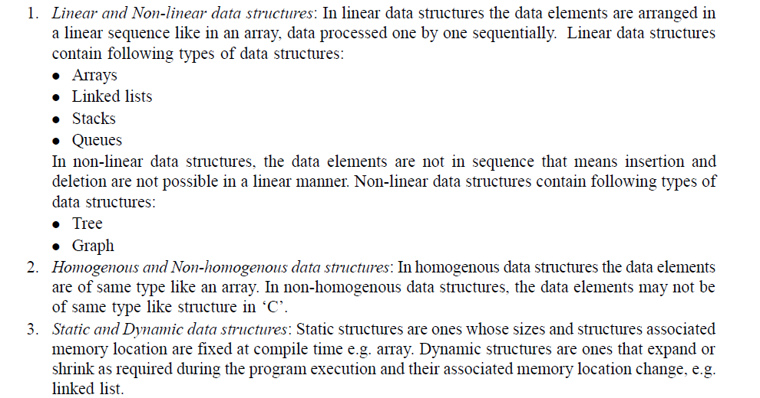
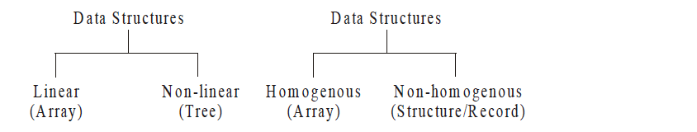

Slide 3
Usual Data Types
Integer, Double, Boolean
You do not know the implementation of these.
There are some operations which can be done with these (add, multiply, read, write)
Programmer just uses these operations without knowing their implementation.

Slide 4
Abstract Data Types (ADTs)
An abstract data type (ADT) is a set of operations.
Abstract data types are mathematical abstractions; nowhere in an ADT’s definition is there any mention of how the set of operations is implemented.
Objects such as lists, sets, and graphs, along with their operations, can be viewed as abstract data types, just as integers, reals, and booleans are data types. Integers, reals, and booleans have operations associated with them, and so do ADTs.

Slide 5
Abstract Data Types (ADTs)
The basic idea is that the implementation of the operations related to ADTs is written once in the program, and any other part of the program that needs to perform an operation on the ADT can do so by calling the appropriate function.
If for some reason implementation details need to be changed, it should be easy to do so by merely changing the routings that perform the ADT operations.
There is no rule telling us which operations must be supported for each ADT; this is a design decision.

Slide 6
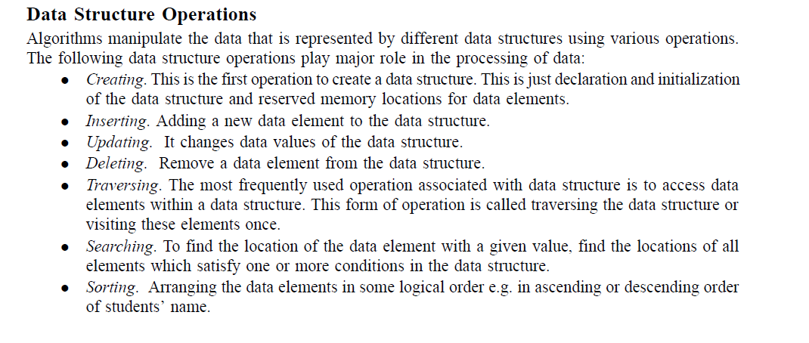

Slide 7
Data Structure
A data structure is the physical implementation of an ADT.
Each operation associated with the ADT is implemented by one or more subroutines in the implementation.
Data structure usually refers to an organization for data in main memory.

Slide 8
Lists
A list is a finite, ordered sequence of data items.
Important concept: List elements have a position.
Notation: <a0, a1, …, an-1>
What operations should we implement?
Notes:
Students should already be familiar with lists.
Chapter objective: Use algorithm analysis in a familiar context to compare implementations.

Slide 9
The List ADT
There is a set of operations that we would like to perform on the list ADT:
PrintList
MakeEmpty
Find: return the position of the first occurrence of a key
Insert and Delete: insert and delete some key from some position in the list
FindKth: return the element in some position
Next and Previous: take a position as argument and return the position of the successor and predecessor

Slide 10
Array Implementation
List can be implemented as an array
Need to know the maximum number of elements in the list at the start of the program

Slide 11
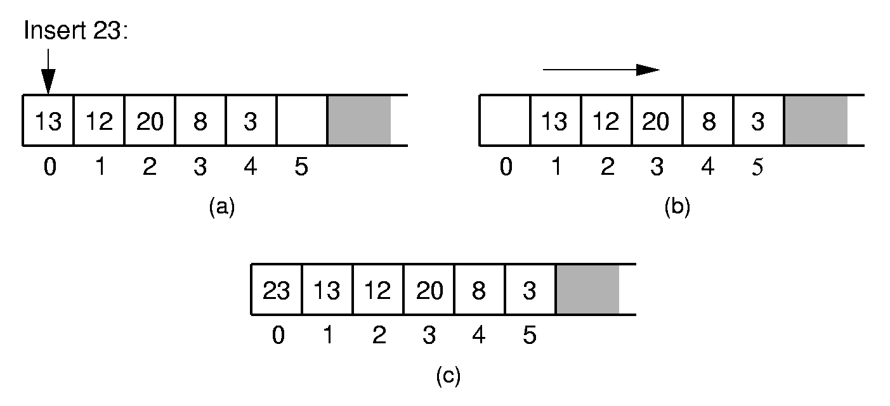
Array-Based List Insert
Notes:
Push items up/down. Cost: Θ(n).

Slide 12
Simple Array Implementation of Lists
Disadvantages:
An estimate of the maximum size of the list is required, even if the array is dynamically allocated. Usually this requires a high overestimate, which wastes considerable space.
Insertion and deletion are expensive. For example, inserting at position 0 requires first pushing the entire array down one spot to make room.
Because the running time for insertions and deletions is so slow and the list size must be known in advance, simple arrays are generally not used to implement lists.

Slide 13
Stack ADT
A stack is a list with the restriction that insertions and deletions can be performed in only one position, namely, the end of the list, called the top.
The fundamental operations on a stack are Push, which is equivalent to an insert, and Pop, which deletes the most recently inserted element.
The most recently inserted element can be examined prior to performing a Pop by use of the Top routine.

Slide 14
Stack ADT
A Pop or Top on an empty stack is generally considered an error (stack underflow error) in the stack ADT.
Running out of space when performing a Push is an implementation error (stack overflow error) but not an ADT error.
Stacks are sometimes known as LIFO (last in, first out) lists.

Slide 15
Stack ADT
Top
7
9
4
2
3
6
Stack model: only the top element is accessible

Slide 16
Implementation of Stacks
Since a stack is a list, any list implementation will do.
We will give two popular implementations. One uses pointers and the other uses an array.
No matter in which case, if we use good programming principles, the calling routines do not need to know which method is being used.

Slide 17
Array Implementation of Stacks
A Stack is defined as a pointer to a structure. The structure contains the TopOfStack and Capacity fields. Once the maximum size is known, the stack array can be dynamically allocated.
Associated with each stack is TopOfStack, which is -1 for an empty stack (this is how an empty stack is initialized).

Slide 18
Array Implementation of Stacks
To push some element X onto the stack, we increment TopOfStack and then set Stack[TopOfStack]=X, where Stack is the array representing the actual stack.
To pop, we set the return value to Stack[TopOfStack] and then decrement TopOfStack.

Slide 19
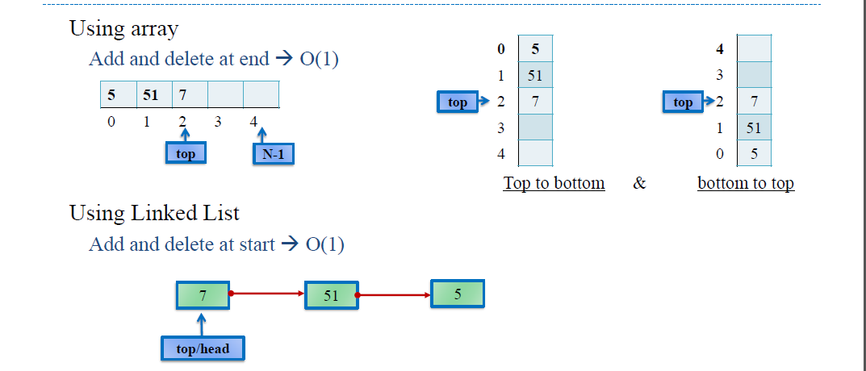

Slide 20
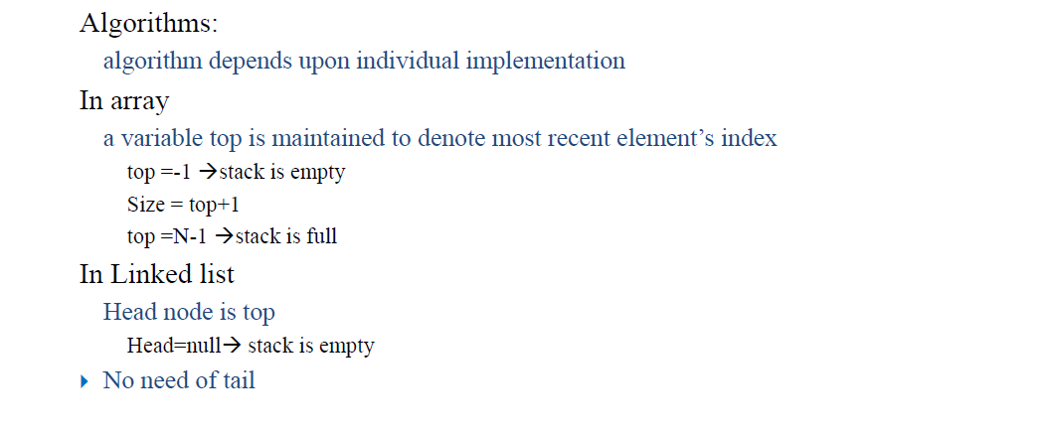
Implementation

Slide 21
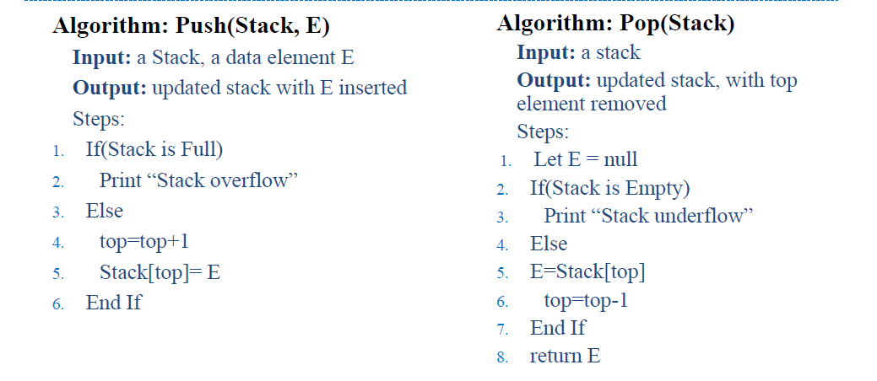
Algorithm (Array base)

Slide 22
Array Implementation of Stacks

Slide 23
Array Implementation of Stacks

Slide 24
Application of Stacks
Methods calls within a program, functions are called in order and data is stored
in activation stack
Back button on browser store page history
Undo/redo in editors
Used by compilers to check program syntax
Arithmetic Expression Evaluation
To reverse contents of something like string, array
Decimal to binary conversion

